Slide 1
2D game effects
Course : 2D Game Programming
Effective Period : September 2018

Slide 2
These slides have been adapted from: Pereira, V. (2014). Learning Unity 2D Game Development by Example, Packt Publishing, Inc. San Francisco. ISBN: 9781783559046 Chapter 9
Acknowledgement

Slide 3
Learning Objectives
LO 1 : Create 2D game for PC platform
LO 2 : Apply best practices of 2D game development
LO 3 : Design 2D game for PC platform

Slide 4
What is a Particle System?
Particles are small, simple images or meshes that are displayed and moved in great numbers by a particle system. Each particle represents a small portion of a fluid or amorphous entity and the effect of all the particles together creates the impression of the complete entity. Using a smoke cloud as an example, each particle would have a small smoke texture resembling a tiny cloud in its own right. When many of these mini-clouds are arranged together in an area of the scene, the overall effect is of a larger, volume-filling cloud.

Slide 5
Dynamics of the System
Each particle has a predetermined lifetime, typically of a few seconds, during which it can undergo various changes. It begins its life when it is generated or emitted by its particle system. The system emits particles at random positions within a region of space shaped like a sphere, hemisphere, cone, box or any arbitrary mesh. The particle is displayed until its time is up, at which point it is removed from the system. The system’s emission rate indicates roughly how many particles are emitted per second, although the exact times of emission are randomized slightly. The choice of emission rate and average particle lifetime determine the number of particles in the “stable” state (ie, where emission and particle death are happening at the same rate) and how long the system takes to reach that state.

Slide 6
Dynamics of Particles
The emission and lifetime settings affect the overall behaviour of the system but the individual particles can also change over time. Each one has a velocity vector that determines the direction and distance the particle moves with each frame update. The velocity can be changed by forces and gravity applied by the system itself or when the particles are blown around by a wind zone on a Terrain. The color, size and rotation of each particle can also change over its lifetime or in proportion to its current speed of movement. The color includes an alpha (transparency) component, so a particle can be made to fade gradually in and out of existence rather than simply appearing and disappearing abruptly.
Used in combination, particle dynamics can be used to simulate many kinds of fluid effects quite convincingly. For example, a waterfall can be simulated by using a thin emission shape and letting the water particles simply fall under gravity, accelerating as they go. Smoke from a fire tends to rise, expand and eventually dissipate, so the system should use an upward force on the smoke particles and increase their size and transparency over their lifetimes.

Slide 7
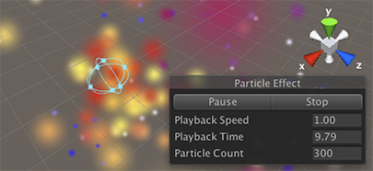
Adding Particle Effects
Go to GameObject | Create Other | Particle System.
Since the component is quite complicated, the inspector is divided into a number of collapsible sub-sections or modules that each contain a group of related properties. Additionally, you can edit one or more systems at the same time using a separate editor window accessed via the Open Window button on the inspector. The many options available for the Particle System component are described in detail on its component reference page and the pages for the individual modules.
Image Source:
http://docs.unity3d.com/Manual/ParticleSystems.html

Slide 8
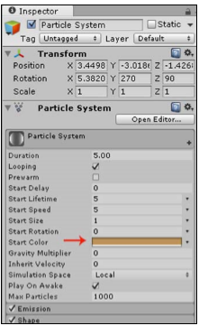
Adding Particle Effects
Select the particle system in the hierarchy.
Then, within the Inspector, click on the Particle System heading to open it. Now, click on Start Color, and change it to a light brown, as shown in the following screenshot:
Image source:
Pereira, V. (2014). Learning Unity 2D Game Development by Example. Packt Publishing, Inc. San Francisco.

Slide 9
Particle Properties
Many of the numeric properties of particles or even the whole system can be varied over time. Unity provides several different methods of specifying how the variation will happen
Constant: The property’s value is fixed throughout its lifetime.
Curve: The value is specified by a curve/graph.
Random between two constants: Two constant values define the upper and lower bounds for the value; the actual value varies randomly over time between those bounds.
Random between two curves: Two curves define the upper and lower bounds of the the value at a given point in its lifetime; the current value varies randomly between those bounds.

Slide 10
Color Properties
Gradient: The color value is taken from a gradient.
Random between two gradients: Two gradients define upper and lower “bounds” on the color value at a given time; the value used is a randomly weighted average of the two bound colors.

Slide 11
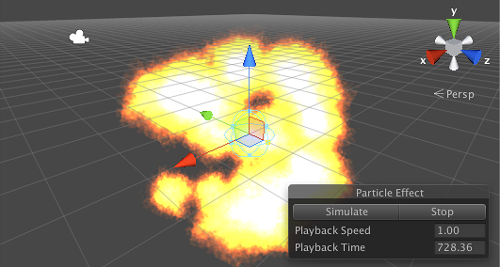
A Simple Explosion
You can use a particle system to create a convincing explosion but the dynamics are perhaps a little more complicated than they seem at first. At its core, an explosion is just an outward burst of particles but there are a few simple modifications you can apply to make it look much more realistic.
Image Source:
http://docs.unity3d.com/Manual/ParticleSystems.html

Slide 12
A Simple Explosion
Timeline of a Particle
A simple explosion produces a ball of flame that expands outward rapidly in all directions. The initial burst has a lot of energy and is therefore very hot (ie, bright) and moves very fast. This energy quickly dissipates which results in the expansion of flame slowing down and also cooling down (ie, getting less bright). Finally, as all the fuel is burned up, the flames will die away and soon disappear completely.
An explosion particle will typically have a short lifetime and you can vary several different properties over that lifetime to simulate the effect. The particle will start off moving very fast but then its speed should reduce greatly as it moves away from the centre of the explosion. Also, the color should start off bright but then darken and eventually fade to transparency. Finally, reducing the particle’s size over its lifetime will give the effect of the flames dispersing as the fuel is used up.

Slide 13
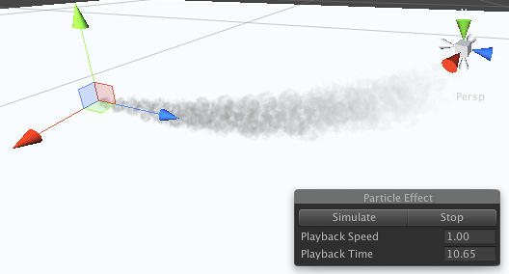
Exhaust Smoke from a Vehicle
Cars and many other vehicles emit exhaust smoke as they convert fuel into power. You can use a particle system to add an exhaust as a nice finishing touch for a vehicle.
Image Source:
http://docs.unity3d.com/Manual/ParticleSystems.html

Slide 14
Exhaust Smoke from a Vehicle
Timeline of a Particle
Exhaust smoke emerges from the pipe quite fast but then rapidly slows down on contact with the atmosphere. As it slows, it spreads out, becoming fainter and soon dissipating into the air. Since the exhaust gas is hot, it also rises slightly as it passes through the colder air surrounding it.
A particle of exhaust smoke must start off no larger than the width of the pipe but it will then grow in size considerably over its short lifetime. It will usually start off partly transparent and fade to total transparency as it mixes with the air. As regards dynamics, the particle will be emitted quite fast but then slow rapidly and will also lift upward slightly.

Slide 15
Discussion
What are the use of particle in game?
Does it can only be used for effects?

Slide 16
References
Calabrese, D. (2014). Unity 2D Game Development. Packt Publishing, Inc. San Francisco. ISBN: 9781783559046
Freeman, J. (2015). Unity’s New 2D Workflow
Vidyasagar. (2014. Unity and C#: Game Loop.CodeProject
Pereira, V. (2014). Learning Unity 2D Game Development by Example. Packt Publishing, Inc. San Francisco. ISBN: 9781783559046
Unity. (2016). Unity Manual Documentation. http://docs.unity3d.com/Manual/

